Slide 1
Adv. Biopharmaceutics
Dr. Mohammed Sabbar
College Of Pharmacy - Basrah
3rd Oct. 2018
http://bit.do/ex2aD

Slide 4
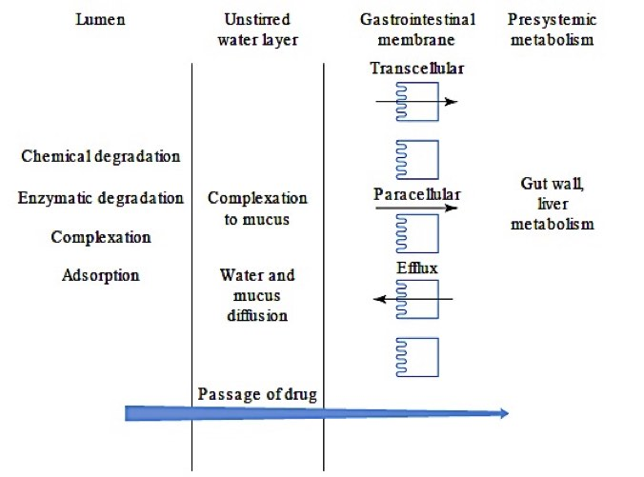

Slide 5
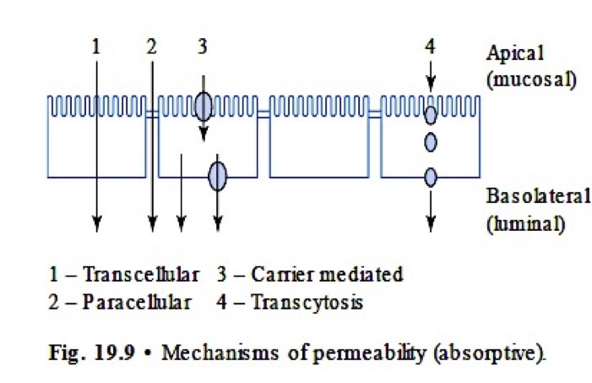

Slide 6
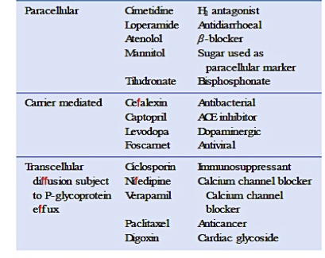

Slide 7
Drugs that Affect Absorption of Other Drugs
Anticholinergic drugs (side effect’s)
Cholinergic drugs (side effect’s)
Antacids
ion-exchange resin
Absorption of calcium and vit D

Slide 8
Nutrients that Interfere with Drug Absorption
Absorption of water-soluble vitamins, such as vitamin B-12 and folic acid, are aided by special absorption mechanisms. Vitamin B-12 absorption is facilitated by intrinsic factors in the stomach, where it forms a complex with the factor and is carried in the intestinal stream to the ileum, where it binds to a specific receptor. Vitamin B-12 then ultimately disassociates from the complex and is absorbed.
Grapefruit juice often increases bioavailability of many drugs that are substrates for cytochrome P450 (CYP) 3A4. Grapefruit juice contains various flavonoids such as naringin that inhibits certain cytochrome P-450 enzymes involved in drug metabolism.

Slide 9
Thank you

